Slide 1
Heapsort
Algorithms

Slide 2
Overview
In this chapter, we introduce another sorting algorithm. Like merge sort, but unlike insertion sort, heapsort's running time is O(n lg n).
Like insertion sort, but unlike merge sort, heapsort sorts in place: only a constant number of array elements are stored outside the input array at any time. Thus, heapsort combines the better attributes of the two sorting algorithms we have already discussed.
Heapsort also introduces another algorithm design technique: the use of a data structure, in this case one we call a "heap," to manage information during the execution of the algorithm. Not only is the heap data structure useful for heapsort, but is also makes an efficient priority queue. The heap data structure will reappear in algorithms in later chapters.

Slide 3
Overview
We note that the term "heap" was originally coined in the context of heapsort, but it has since come to refer to "garbage-collected storage," such as the programming languages Lisp and Java provide.
Our heap data structure is not garbage-collected storage, and whenever we refer to heaps in this book, we shall mean the structure defined in this chapter.

Slide 4
Heapsort
Combines the better attributes of merge sort and insertion sort.
  Like merge sort, but unlike insertion sort, running time is O(n lg n).
  Like insertion sort, but unlike merge sort, sorts in place.
Introduces an algorithm design technique
  Create data structure (heap) to manage information during the execution of an algorithm.
The heap has other applications beside sorting.
  Priority Queues

Slide 5
Data Structure Binary Heap
Array viewed as a nearly complete binary tree.
  Physically – linear array.
  Logically – binary tree, filled on all levels (except lowest.)
Map from array elements to tree nodes and vice versa
  Root – A[1]
  Left[i] – A[2i]
  Right[i] – A[2i+1]
  Parent[i] – A[⎣i/2⎦]
length[A] – number of elements in array A.
heap-size[A] – number of elements in heap stored in A.
  heap-size[A] ≤ length[A]

Slide 6
Heap Property (Max and Min)
Max-Heap
  For every node excluding the root,
  value is at most that of its parent: A[parent[i]] ≥ A[i]
Largest element is stored at the root.
In any subtree, no values are larger than the value stored at subtree root.
Min-Heap
  For every node excluding the root,
  value is at least that of its parent: A[parent[i]] ≤ A[i]
Smallest element is stored at the root.
In any subtree, no values are smaller than the value stored at subtree root

Slide 7
Heaps – Example
26
24
20
18
17
19
13
12
14
11
Max-heap as an
array.
1 2 3 4 5 6 7 8 9 10
Max-heap as a binary
tree.
26
24
20
18
17
19
13
12
14
11
Last row filled from left to right.

Slide 8
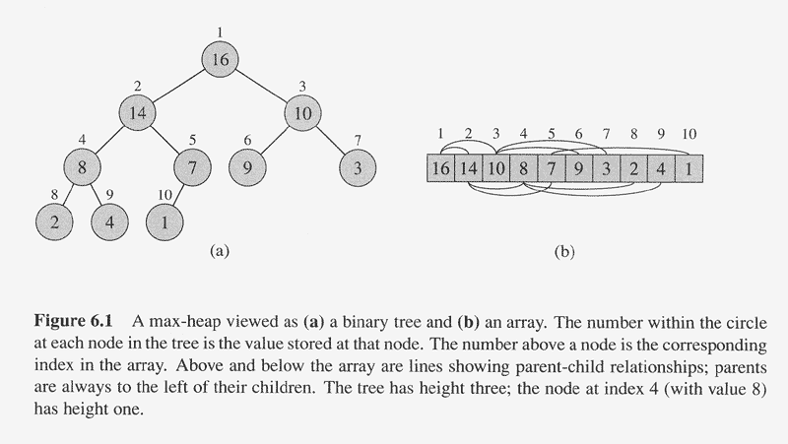

Slide 9
Height
Height of a node in a tree: the number of edges on the longest simple downward path from the node to a leaf.
Height of a tree: the height of the root.
Height of a heap: ⎡lg n⎤
  Basic operations on a heap run in O(lg n) time

Slide 10
Referencing Heap Elements
So…
  Parent(i) { return ⎣i/2⎦; }
  Left(i) { return 2*i; }
  right(i) { return 2*i + 1; }
An aside: How would you implement this
most efficiently?
Another aside: Really?

Slide 11
The Heap Property
Heaps also satisfy the heap property:
A[Parent(i)] ≥ A[i] for all nodes i > 1
  In other words, the value of a node is at most the value of its parent
  Where is the largest element in a heap stored?
Definitions:
  The height of a node in the tree = the number of edges on the longest downward path to a leaf
  The height of a tree = the height of its root

Slide 12
Heaps in Sorting
Use max-heaps for sorting.
The array representation of max-heap is not sorted.
Steps in sorting
  Convert the given array of size n to a max-heap (BuildMaxHeap)
  Swap the first and last elements of the array.
    Now, the largest element is in the last position – where it belongs.
    That leaves n – 1 elements to be placed in their appropriate locations.
    However, the array of first n – 1 elements is no longer a max-heap.
    Float the element at the root down one of its subtrees so that the array remains a max-heap (MaxHeapify)
    Repeat step 2 until the array is sorted.

Slide 13
Heap Characteristics
Height = ⎡lg n⎤
No. of leaves = ⎡n/2⎤
No. of nodes of
height h ≤ ⎡n/2^{h+1}⎤

Slide 14
Maintaining the heap property
Suppose two subtrees are max-heaps,
but the root violates the max-heap
property.
Fix the offending node by exchanging the value at the node with the larger of the values at its children.
  May lead to the subtree at the child not being a heap.
Recursively fix the children until all of them satisfy the max-heap property.

Slide 15
Review: Heapify()
Heapify(): maintain the heap property
  Given: a node i in the heap with children l and r
  Given: two subtrees rooted at l and r, assumed to be heaps
  Action: let the value of the parent node “float down” so subtree at i satisfies the heap property
    If A[i] < A[l] or A[i] < A[r], swap A[i] with the largest of A[l] and A[r]
    Recurse on that subtree
  Running time: O(h), h = height of heap = O(lg n)

Slide 16
MaxHeapify – Example
MaxHeapify(A, 2)
26
24
24
14
20
14
18
17
19
18
14
14
24
13
12
14
14
18
11

Slide 17
Procedure MaxHeapify
MaxHeapify(A, i)
1. l ← left(i)
2. r ← right(i)
3. if l ≤ heap-size[A] and A[l] > A[i]
4. then largest ← l
5. else largest ← i
6. if r ≤ heap-size[A] and A[r] > A[largest]
7. then largest ← r
8. if largest≠ i
9. then exchange A[i] ↔ A[largest]
10. MaxHeapify(A, largest)
Assumption:
Left(i) and Right(i) are max-heaps.

Slide 18
Running Time for MaxHeapify
MaxHeapify(A, i)
1. l ← left(i)
2. r ← right(i)
3. if l ≤ heap-size[A] and A[l] > A[i]
4. then largest ← l
5. else largest ← i
6. if r ≤ heap-size[A] and A[r] > A[largest]
7. then largest ← r
8. if largest≠ i
9. then exchange A[i] ↔ A[largest]
10. MaxHeapify(A, largest)
Time to fix node i and its children = Θ(1)
PLUS
Time to fix the subtree rooted at one of i’s children = T(size of subree at largest)

Slide 19
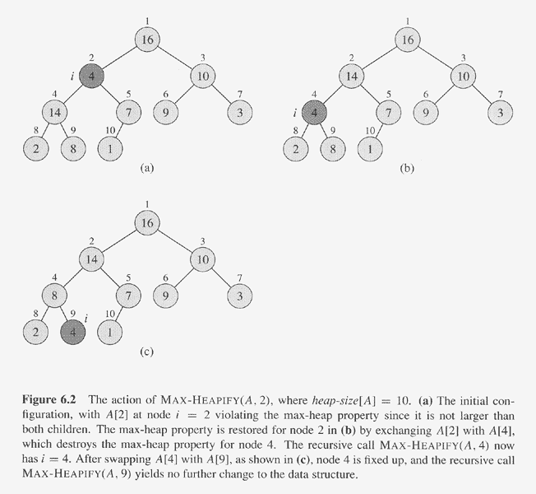

Slide 20
Heapify() Example
16
4
10
14
7
9
3
2
8
1
A =
16
4
10
14
7
9
3
2
8
1

Slide 21
Heapify() Example
16
4
10
14
7
9
3
2
8
1
A =
16
4
10
14
7
9
3
2
8
1

Slide 22
Heapify() Example
16
4
10
14
7
9
3
2
8
1
A =
16
4
10
14
7
9
3
2
8
1

Slide 23
Heapify() Example
16
14
10
4
7
9
3
2
8
1
A =
16
14
10
4
7
9
3
2
8
1

Slide 24
Heapify() Example
16
14
10
4
7
9
3
2
8
1
A =
16
14
10
4
7
9
3
2
8
1

Slide 25
Heapify() Example
16
14
10
4
7
9
3
2
8
1
A =
16
14
10
4
7
9
3
2
8
1

Slide 26
Heapify() Example
16
14
10
8
7
9
3
2
4
1
A =
16
14
10
8
7
9
3
2
4
1

Slide 27
Heapify() Example
16
14
10
8
7
9
3
2
4
1
A =
16
14
10
8
7
9
3
2
4
1

Slide 28
Heapify() Example
16
14
10
8
7
9
3
2
4
1
A =
16
14
10
8
7
9
3
2
4
1

Slide 29
Heapify() Example
16
4
10
14
7
9
3
2
8
1
A =
16
4
10
14
7
9
3
2
8
1

Slide 30
Heapify() Example
16
4
10
14
7
9
3
2
8
1
A =
16
4
10
14
7
9
3
2
8
1

Slide 31
Heapify() Example
16
4
10
14
7
9
3
2
8
1
A =
16
4
10
14
7
9
3
2
8
1

Slide 32
Heapify() Example
16
14
10
4
7
9
3
2
8
1
A =
16
14
10
4
7
9
3
2
8
1

Slide 33
Heapify() Example
16
14
10
4
7
9
3
2
8
1
A =
16
14
10
4
7
9
3
2
8
1

Slide 34
Heapify() Example
16
14
10
4
7
9
3
2
8
1
A =
16
14
10
4
7
9
3
2
8
1

Slide 35
Heapify() Example
16
14
10
8
7
9
3
2
4
1
A =
16
14
10
8
7
9
3
2
4
1

Slide 36
Heapify() Example
16
14
10
8
7
9
3
2
4
1
A =
16
14
10
8
7
9
3
2
4
1

Slide 37
Heapify() Example
16
14
10
8
7
9
3
2
4
1
A =
16
14
10
8
7
9
3
2
4
1

Slide 38
Building a heap
Use MaxHeapify to convert an array A into a max-heap.
How?
Call MaxHeapify on each element in a bottom-up manner.
BuildMaxHeap(A)
1. heap-size[A] ← length[A]
2. for i ← ⎣length[A]/2⎦ downto 1
3. do MaxHeapify(A, i)

Slide 39
Creating a Heap from a CBT
7
1
7
5
6
1
1
7
6
2
7
4
4
3
5
5
6
7
1
2
1
2
4

Slide 40
Sift-Up
Aliases
  Sift-down
  Percolate up
  Percolate down
The Idea
  Assume all nodes in tree have the heap property w.r.t. there children, except for current node N.
  Compare N to T_{L} and T_{R}
  Swap N and root of T_{L} or T_{R}, which ever is greater.
  Recurse down until N is greater then T_{L} and T_{R}

Slide 41
Sift-Up Cont...
  if (k < max (k_{L}, k_{R}))
  if (k_{L} ≥ k_{R})
  swap(k_{L},k)
  else
swap(k_{R},k)
k
k_{l}
k_{r}
T_{L}
T_{R}
Once an exchange takes place the subtree must be checked for the heap property.
  so we recurse down the tree.

Slide 42
Sift-Up Cont...
  Given T pointing to the root of a tree (subtree) where k is the key, & subtrees T_{L} & T_{R} with keys k_{L} & k_{R} which are heaps.
  N = T
  1) k = key(N); T_{L} = Lt_subtree; T_{R} = Rt_subtree;
  k_{L} = key(T_{L}); k_{R} = key(T_{R})
  2) if (k ≥ k_{L} && k ≥ k_{R}) exit
  3) if (k_{L} > k_{R})
  exchange keys of N and T_{L}
  N = T_{L}
  else
  exchange keys of N and T_{R}
  N = T_{R}
  goto 2

Slide 43
BuildMaxHeap – Example
Input Array:
24
21
23
22
36
29
30
34
28
27
Initial Heap:
(not max-heap)
24
21
23
22
36
29
30
34
28
27

Slide 44
BuildMaxHeap – Example
MaxHeapify(⎣10/2⎦ = 5)
MaxHeapify(4)
24
36
MaxHeapify(3)
24
MaxHeapify(2)
21
30
34
24
21
23
36
23
MaxHeapify(1)
36
36
27
21
29
36
21
30
28
23
34
22
24
22
34
22
28
24
27
21

Slide 45
Correctness of BuildMaxHeap
Loop Invariant: At the start of each iteration of the for loop, each node i+1, i+2, …, n is the root of a max-heap.
Initialization:
  Before first iteration i = ⎣n/2⎦
  Nodes ⎣n/2⎦+1, ⎣n/2⎦+2, …, n are leaves and hence roots of max-heaps.
Maintenance:
  By LI, subtrees at children of node i are max heaps.
  Hence, MaxHeapify(i) renders node i a max heap root (while preserving the max heap root property of higher-numbered nodes).
  Decrementing i reestablishes the loop invariant for the next iteration.

Slide 46
Running Time of BuildMaxHeap
Loose upper bound:
  Cost of a MaxHeapify call × No. of calls to MaxHeapify
  O(lg n) × O(n) = O(nlg n)
Tighter bound:
  Cost of a call to MaxHeapify at a node depends on the height, h, of the node – O(h).
  Height of most nodes smaller than n.
  Height of nodes h ranges from 0 to ⎣lg n⎦.
  No. of nodes of height h is ⎡n/2^{h+1}⎤

Slide 47
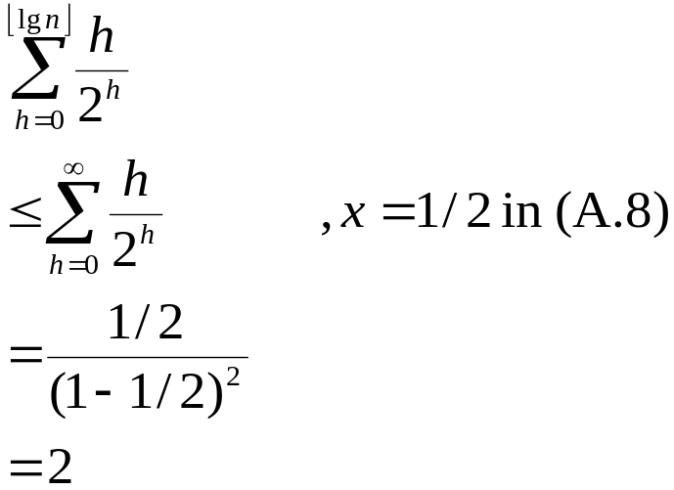
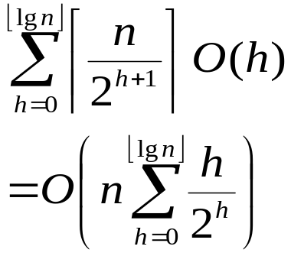
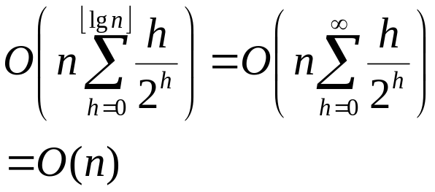
Running Time of BuildMaxHeap
Tighter Bound for T(BuildMaxHeap)
T(BuildMaxHeap)
Can build a heap from an unordered array in linear time

Slide 48
Heapsort
Sort by maintaining the as yet unsorted elements as a max-heap.
Start by building a max-heap on all elements in A.
  Maximum element is in the root, A[1].
Move the maximum element to its correct final position.
  Exchange A[1] with A[n].
Discard A[n] – it is now sorted.
  Decrement heap-size[A].
Restore the max-heap property on A[1..n–1].
  Call MaxHeapify(A, 1).
Repeat until heap-size[A] is reduced to 2.

Slide 49
Heap Sort
Algorithm
  1) Take the keys k₁…k_{n} & put them in a CBT
  2) Use siftup to turn the CBT into a heap
  3) Repeat the following until heap is empty
    a) Remove the root & put in an o/p queue
    b) Remove right most leaf at deepest level & put its' key on the root.
    c) Apply siftup to make the CBT into a heap again

Slide 50
Heap Sort Example
CBT with 6 integers
3 9 8 1 4 2
3
9
9
8
4
8
CBT to Heap
1
4
2
1
3
2

Slide 51
Heap Sort Example Cont….
2
3
4
1
3
2
1
9
8
3
4
1
8
2
1
3
2
Output Queue
9
8
4
3
2
1

Slide 52
Heapsort(A)
HeapSort(A)
1. Build-Max-Heap(A)
2. for i ← length[A] downto 2
3. do exchange A[1] ↔ A[i]
4. heap-size[A] ← heap-size[A] – 1
5. MaxHeapify(A, 1)

Slide 53
Heapsort – Example
26
24
20
18
17
19
13
12
14
11
1 2 3 4 5 6 7 8 9 10
26
24
20
18
17
19
13
12
14
11

Slide 54
Algorithm Analysis
HeapSort(A)
1. Build-Max-Heap(A)
2. for i ← length[A] downto 2
3. do exchange A[1] ↔ A[i]
4. heap-size[A] ← heap-size[A] – 1
5. MaxHeapify(A, 1)
In-place
Not Stable
Build-Max-Heap takes O(n) and each of the n-1 calls to Max-Heapify takes time O(lg n).
Therefore, T(n) = O(n lg n)

Slide 55
Heap Procedures for Sorting
MaxHeapify O(lg n)
BuildMaxHeap O(n)
HeapSort O(n lg n)

Slide 56
Priority Queues
Heapsort is a nice algorithm, but in practice Quicksort (coming up) usually wins
But the heap data structure is incredibly useful for implementing priority queues
  A data structure for maintaining a set S of elements, each with an associated value or key
  Supports the operations Insert(), Maximum(), and ExtractMax()
  What might a priority queue be useful for?

Slide 57
Priority Queue
Popular & important application of heaps.
Max and min priority queues.
Maintains a dynamic set S of elements.
Each set element has a key – an associated value.
Goal is to support insertion and extraction efficiently.
Applications:
  Ready list of processes in operating systems by their priorities – the list is highly dynamic
  In event-driven simulators to maintain the list of events to be simulated in order of their time of occurrence.

Slide 58
Basic Operations
Operations on a max-priority queue:
  Insert(S, x) - inserts the element x into the set S
    S ← S ∪ {x}.
  Maximum(S) - returns the element of S with the largest key.
  Extract-Max(S) - removes and returns the element of S with the largest key.
  Increase-Key(S, x, k) – increases the value of element x’s key to the new value k.
Min-priority queue supports Insert, Minimum, Extract-Min, and Decrease-Key.
Heap gives a good compromise between fast insertion but slow extraction and vice versa.

Slide 59
Heap Property (Max and Min)
Max-Heap
  For every node excluding the root,
  value is at most that of its parent: A[parent[i]] ≥ A[i]
Largest element is stored at the root.
In any subtree, no values are larger than the value stored at subtree root.
Min-Heap
  For every node excluding the root,
  value is at least that of its parent: A[parent[i]] ≤ A[i]
Smallest element is stored at the root.
In any subtree, no values are smaller than the value stored at subtree root

Slide 60
Heap-Extract-Max(A)
Implements the Extract-Max operation.
Heap-Extract-Max(A)
1. if heap-size[A] < 1
2. then error “heap underflow”
3. max ← A[1]
4. A[1] ← A[heap-size[A]]
5. heap-size[A] ← heap-size[A] - 1
6. MaxHeapify(A, 1)
7. return max
Running time : Dominated by the running time of MaxHeapify
= O(lg n)

Slide 61
Heap-Insert(A, key)
Heap-Insert(A, key)
1. heap-size[A] ← heap-size[A] + 1
i ← heap-size[A]
4. while i > 1 and A[Parent(i)] < key
5. do A[i] ← A[Parent(i)]
6. i ← Parent(i)
7. A[i] ← key
Running time is O(lg n)
  The path traced from the new leaf to the root has length O(lg n)

Slide 62
Heap-Increase-Key(A, i, key)
Heap-Increase-Key(A, i, key)
If key < A[i]
then error “new key is smaller than the current key”
A[i] ← key
while i > 1 and A[Parent[i]] < A[i]
do exchange A[i] ↔ A[Parent[i]]
i ← Parent[i]
Heap-Insert(A, key)
heap-size[A] ← heap-size[A] + 1
A[heap-size[A]] ← –∞
Heap-Increase-Key(A, heap-size[A], key)

